Slide 1
Google Study
401(k) contribution
Jan 17th 2023

Slide 2


Background- 401(k)
A 401(k) plan is a retirement savings plan offered by many US employers.
Employers may match contributions

Slide 3
Findings
Status Quo
Aggressive Goals
Employer suggest small contribution
e.g. $2,000
Employee contributes small portion
Employer suggest “aggressive” contribution
e.g. $8,000
Employee contribution > $2,000 target
Even if employee cannot afford large amount will save more than with status quo
Vs.

Slide 4
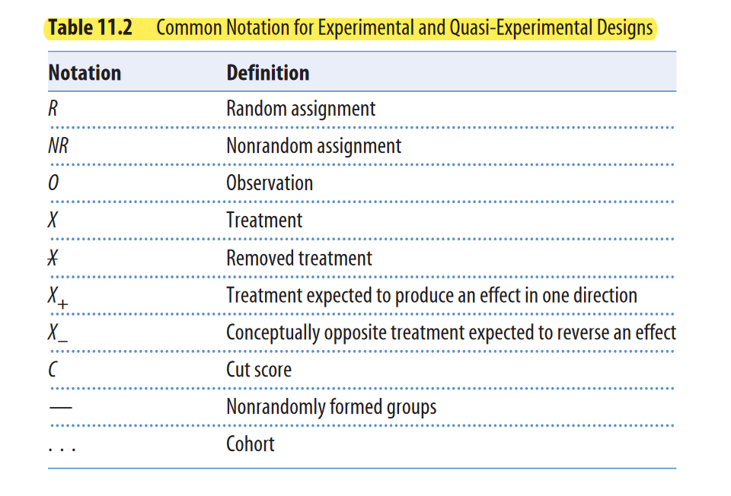
Experimental Design

Slide 5
Experimental Design
R | O₁ | X | O₂
R | O₁ |  | O₂
A randomly selected subgroup of employees can receive the ‘ aggressive’ 401K recommendation which can be compared to their previous saving behavior or the aggregate savings behavior

Slide 6
Threats to Design
Demographic Distribution
Authority Problem
Salary distribution may not be normally distrusted
Outliers (C-suite)
Age distribution may not be normally distributed
People may not consent to their data being shared.
People may also feel like their savings are being dictated to.
Saving > Afford to save
Sample size=population of google employees
Savings brackets & Opt-out

Slide 7
Threats to Design - II
Equity Threat
Cross Contamination
Some may benefit more than others which may create animosity
Employees influenced by others
Aggressive vs. non-aggressive prompting
Limit trial time frame
Financial advice disclaimer

Slide 8
Managerial practices challenge
Manager’s motivation tactics → Employee Perf.
Motivation Tactic A 9% (Motivates) 91% (Demotivates)
Motivation Tactic B 91% (Motivates) 9% (Demotivates)
“Expert” says Tactic A HELPS employee performance and Tactic B HARMS employee performance
How to figure out who is right?

Slide 9
Our thoughts on tactics
Treatment A:
Better performance than pervious day
Treatment B:
May have long term effects

Slide 10



The expert’s opinion
We can understand the experts opinion on the data
However, this may not capture longer term benefits
Think about giving employees the afternoon off, while fewer productive hours may be better for the long term

Slide 11
Thank you

Slide 12
Rational for implementation
Having a more ‘ aggressive’ savings plan has benefits…

Slide 13



Analysis
Ease retirement
Peace of mind
Future focus
Helps transition older employees to retirement
Younger employees may be more cost effective
Better technical knowledge
Fresh perspective
Lower wages
Removes some of the financial burden for future planning
Builds trust and
Inspires employees to think in the long term
Aligns with Google’s business model and objectives.

Slide 14
Chart- Early retirment
Contribution | $5k/ yr | $5k/ yr
Contribution time | 40 years | 30 years
Rate of return | 8% | 8%
Total amount | $1.4 M | $600K

Slide 15
Use the data from the challenge (on myCourses) to make your own conclusion about which tactic helps employee performance.
Treatment A
Treatment B
Baseline

